Slide 1




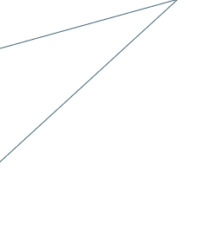































































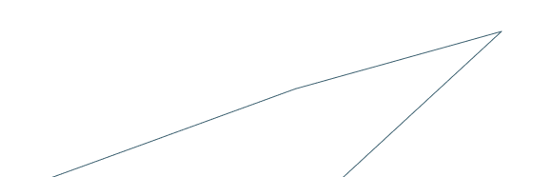




















Biomarkers of Aging to Assess Interventions to Extend Human Healthspan and Resilience
An Open International Collaboration Methodology ​
Creative Commons Licence CC BY-NC 4.0

Slide 2



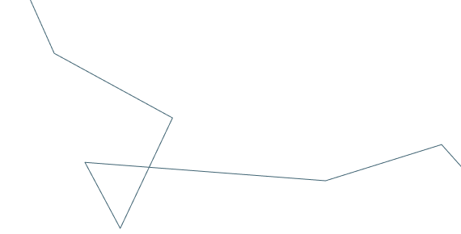
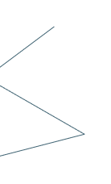


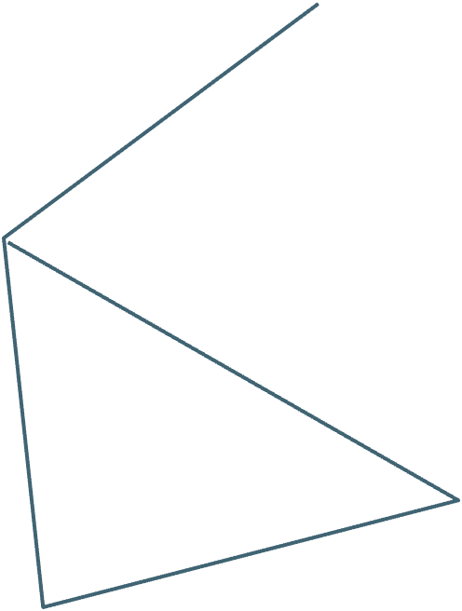




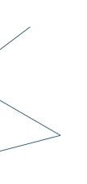
Purpose
Engaging the International Community: A Collective Effort Towards Achieving Global Consensus on Standards, Validation, and Open Decentralized Data Sharing to Use Aging Biomarkers to Assess Interventions to Extend Human Healthspan and Resilience.
Creative Commons Licence CC BY-NC 4.0

Slide 3






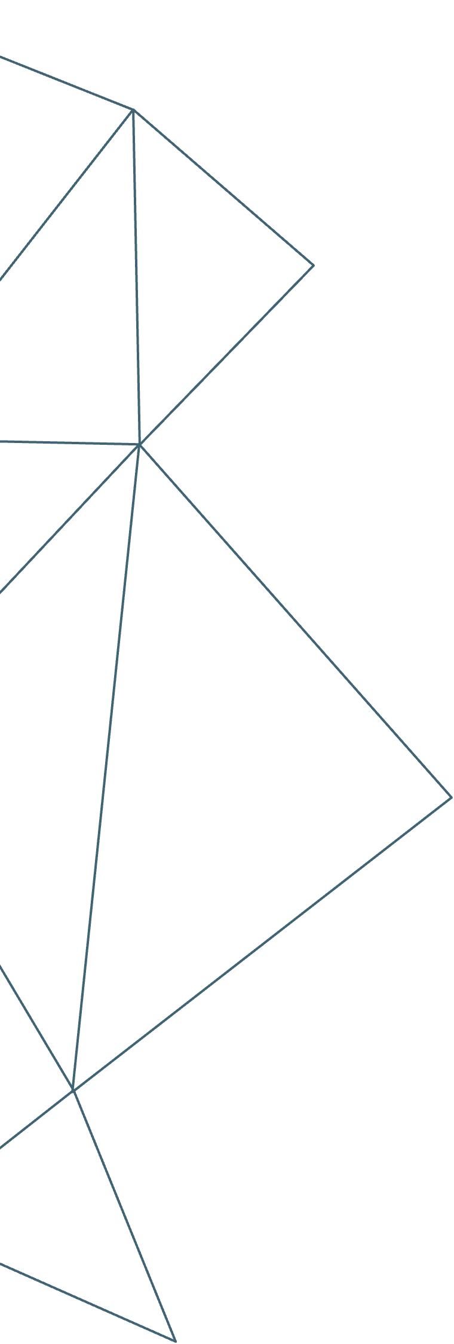



























Objectives
Biomarkers could accelerate and shorten clinical trial times by acting as surrogate endpoints upstream in the health trajectory, and measure risk and progression of major age-related diseases.​
No agreed standard or approved aging biomarkers exist to assess interventions or use in clinical trials, nor is there an international consensus or validated set of aging biomarkers or clocks.​
We must shift from static to dynamic resilience measurement and capture the multifactorial processes in human aging., including causality (identifying biomarkers that correlate with pre-symptomatic steps in the causal chain of events that leads to age-related decline in function).
Closing this gap requires utilizing data-intensive omics, 'effortless AI' (e.g., wearables), and leveraging machine learning, quantum computing, and systems biology.
Creative Commons Licence CC BY-NC 4.0

Slide 4










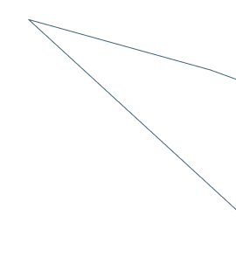






































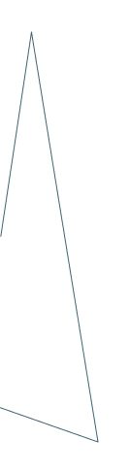













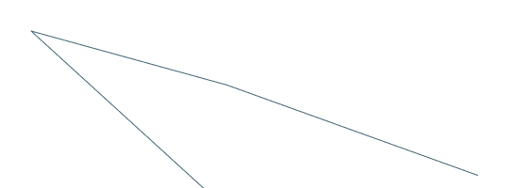


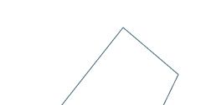



Who are our Stakeholders??
Government and policymakers, regulators, investors, industry, entrepreneurs, scientists, academic researchers​
Creative Commons Licence CC BY-NC 4.0

Slide 5








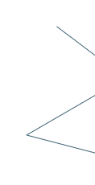

Key questions
Which interventions will work best in which humans?
How do we combine interventions for additive/synergistic effects?
Which biomarkers will be most effective? Systemic/organ-specific/hallmark specific?
How do we adapt preclinical animal models to best predict outcomes in humans?
How to efficiently store, integrate and share multi-omic data from diverse cohorts to support studies on human aging and longevity?
How can the application of AI enable the use of human datasets to develop more effective aging clocks and interventions
Creative Commons Licence CC BY-NC 4.0

Slide 6
How biomarkers may provide answers
Explore the role of biomarkers and clocks as endpoints for clinical trials (trustworthy, verifiable, transparent results) to accelerate and focus research​.
Promote the use of biomarkers of aging to inform studies of baseline characteristics of participants in future and past clinical trials.​
Use biomarkers along with chronological age when it comes to the table of baseline characteristics listed in trials.​
Balance control and interventions/treatments based on biomarkers.​
..... Continued on the next slide
Creative Commons Licence CC BY-NC 4.0

Slide 7









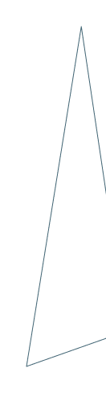












Lay the groundwork for future surrogate endpoints of interventions to delay age-related diseases.​
Build foundational genomic data base that allows researchers to assess causality due to the intervention.​
Use biomarkers to discover age-affecting interventions and assess dynamic resilience to exposomic stressors, while refining biomarkers with successful interventions.
Leverage recent innovations and provide clinical decision support for FDA (and MHRA in UK)- that move beyond monocausal framework.​
Collaborate with other international initiatives including UK Biobank, USA National Institute on Aging’s Predictive Biomarkers Initiative, USA Aging Biomarkers Consortium (Stanford), European MARK-AGE study, UK Our Future Health, and China Aging Biomarkers Consortium, to enhance protocols, integrating diverse exposomic factors and interventions (e.g., diet, exercise, socio-economic) for Healthspan and resilience analysis.
Creative Commons Licence CC BY-NC 4.0

Slide 8


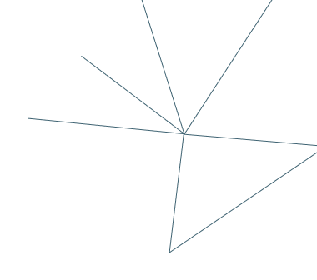








Aging Biomarkers Review​
Examine biomarkers and clocks as reliable clinical trial endpoints for accelerated, focused research on interventions with transparent results.​
Creative Commons Licence CC BY-NC 4.0

Slide 9




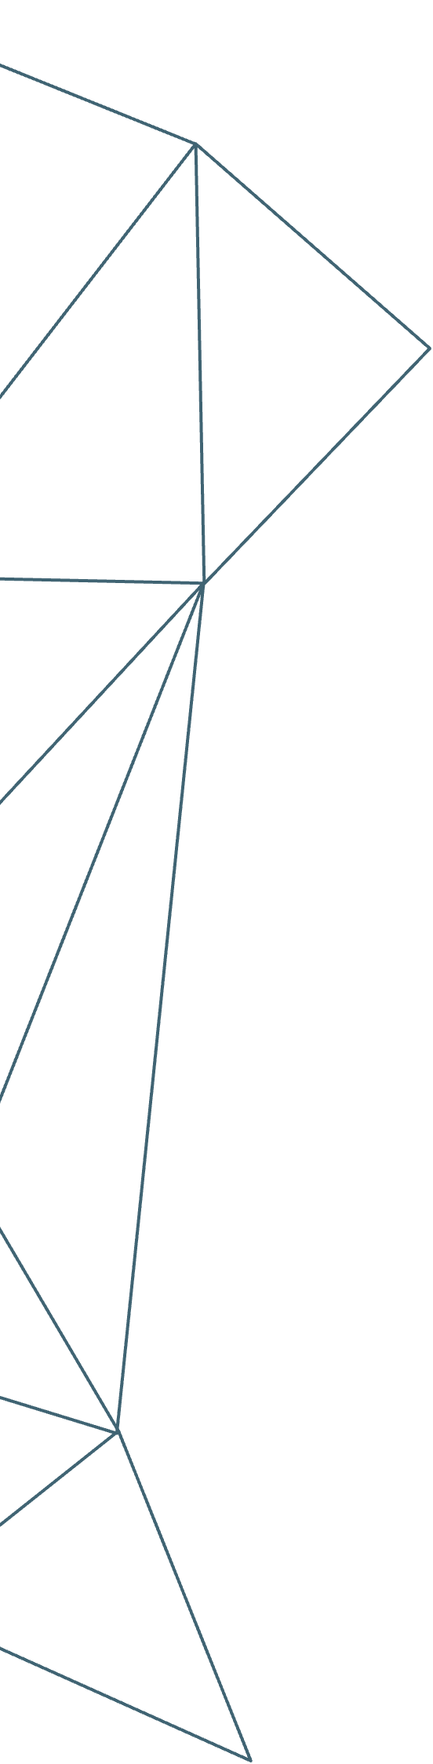






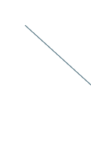
Open Trial Infrastructure​
Include details about the existing infrastructure for decentralized trials, open sources.​
The challenge : Harmonizing unstandardized data formats into a seamless, standardized structure for aging biomarker analysis.
Another challenge: Quantifying longevity intervention effectiveness, uncovering hidden aging exacerbators, and establishing personalized optimal daily values for these factors.
Ideal approach: Facilitate user findings publication and improve predictive analysis accuracy by aggregating data from homogeneous user groups to expand sample sizes.
..... Continued on the next slide
Creative Commons Licence CC BY-NC 4.0

Slide 10



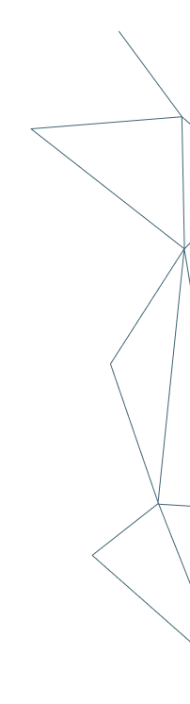















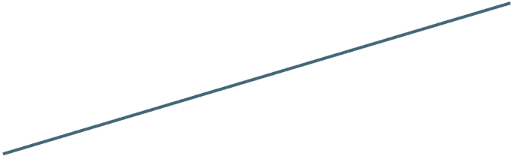
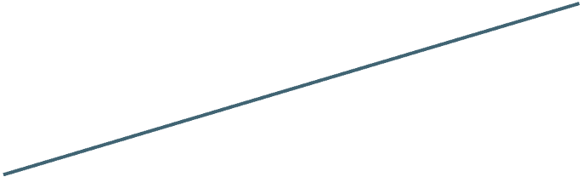
By leveraging machine learning, the platform offers predictive insights, potentially detecting early signs of age-related health changes for early disease prevention.
The platform's data-sharing capability promotes collaborative research, enabling researchers worldwide to expedite the discovery of aging biomarkers.
The platform enables secure data sharing for researchers and healthcare professionals to access aggregated data, aiding broader studies aimed at identifying aging biomarkers.
The platform could compile and analyze data over long periods, an essential feature for studying aging, which is inherently a longitudinal process.
In summary, an open-source digital health platform can revolutionize aging research with real-world data. Strict data security and privacy measures are essential to safeguard user information.
Creative Commons Licence CC BY-NC 4.0

Slide 11


Flow Process
Biomarker Selection and Agreed List: Establish a panel of experts to determine a comprehensive list of biomarkers associated with aging.
Clinical Trial Protocol: Develop a standardized protocol for clinical trials involving aging research.
Blood Sample Collection: Detail the procedure for collecting blood samples from study participants.
Biomarker Measurement - Proteomics: Specify the methodology and assays for proteomics data collection from blood samples.
Biomarker Measurement - Methylation: Define the techniques and platforms for methylation analysis using collected samples.
Biomarker Measurement - Metabolomics: Describe the metabolomics analysis methods, including the equipment and technologies used.
Creative Commons Licence CC BY-NC 4.0

Slide 12

Biomarker Characteristics: Must change in a statistically non chaotic manner in response to interventions, including exercise, diet, sleep, lifestyle factors, drugs, supplements, etc.
Wearable Data Collection: Clarify the types of wearables used for continuous monitoring.
Data Integration and Analysis: Develop protocols for integrating data from proteomics, methylation, metabolomics, and wearables.
Data Validation and Quality Assurance: Establish procedures for data validation and quality control to ensure accuracy and reliability.
Reporting and Interpretation: Outline how aging clock endpoints and biomarker data will be reported to researchers and study participants.
Ethical Considerations: Address ethical concerns related to data collection, participant consent, and data sharing.
Creative Commons Licence CC BY-NC 4.0

Slide 13
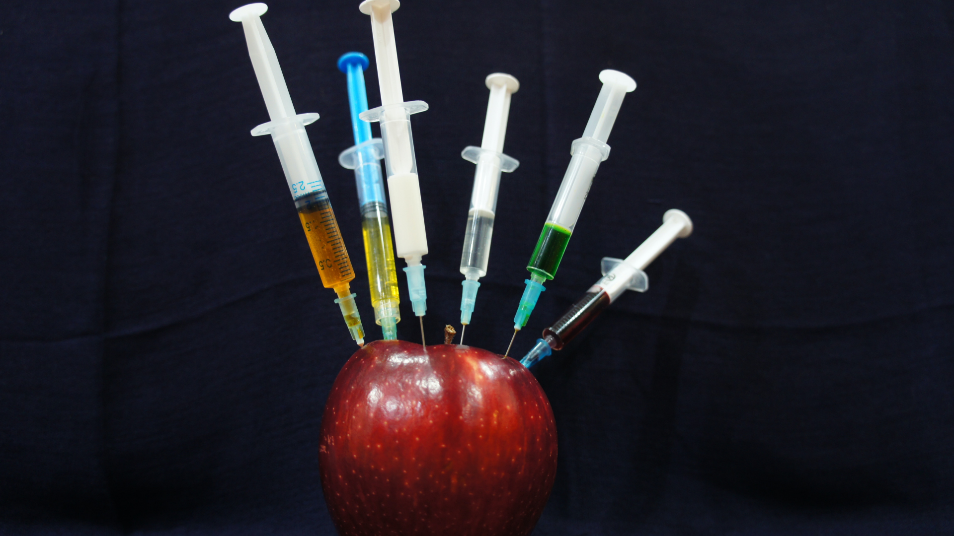






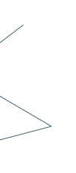
Next Strategic Moves
Include biomarkers differentiating chronological and biological age, responsive to short-term preventative interventions and therapeutics that matter most to humans
Shift to dynamic exposome resilience biomarkers: Seek innovative methods for identification.
Incorporate Organ-Specific Aging Clocks in Clinical Trials: Balancing Organ-Specific Aging with Overall Metrics. Expanding Beyond Age-Related Disease Endpoints.
It’s much easier to convince FDA and other government organizations to focus on organ-specific age-related deterioration than all-cause mortality.
We have organ-specific risk assessment clocks for the Brain, Liver, Kidney, and the Immune System (Immune-Age).
Creative Commons Licence CC BY-NC 4.0

Slide 14






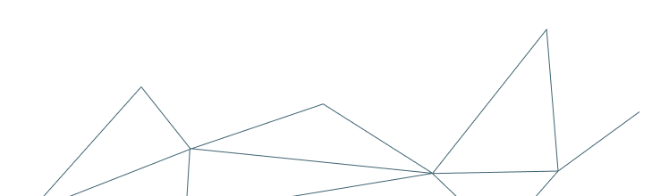
Health Metrics
Unbiased AI models rely on diverse demographic data. Create global, cost-effective metrics using wearables and standard blood panels for trials.
Efforts to enhance aging clocks through various data sources can yield surrogate clocks from affordable wearables and blood markers.
Creative Commons Licence CC BY-NC 4.0

Slide 15


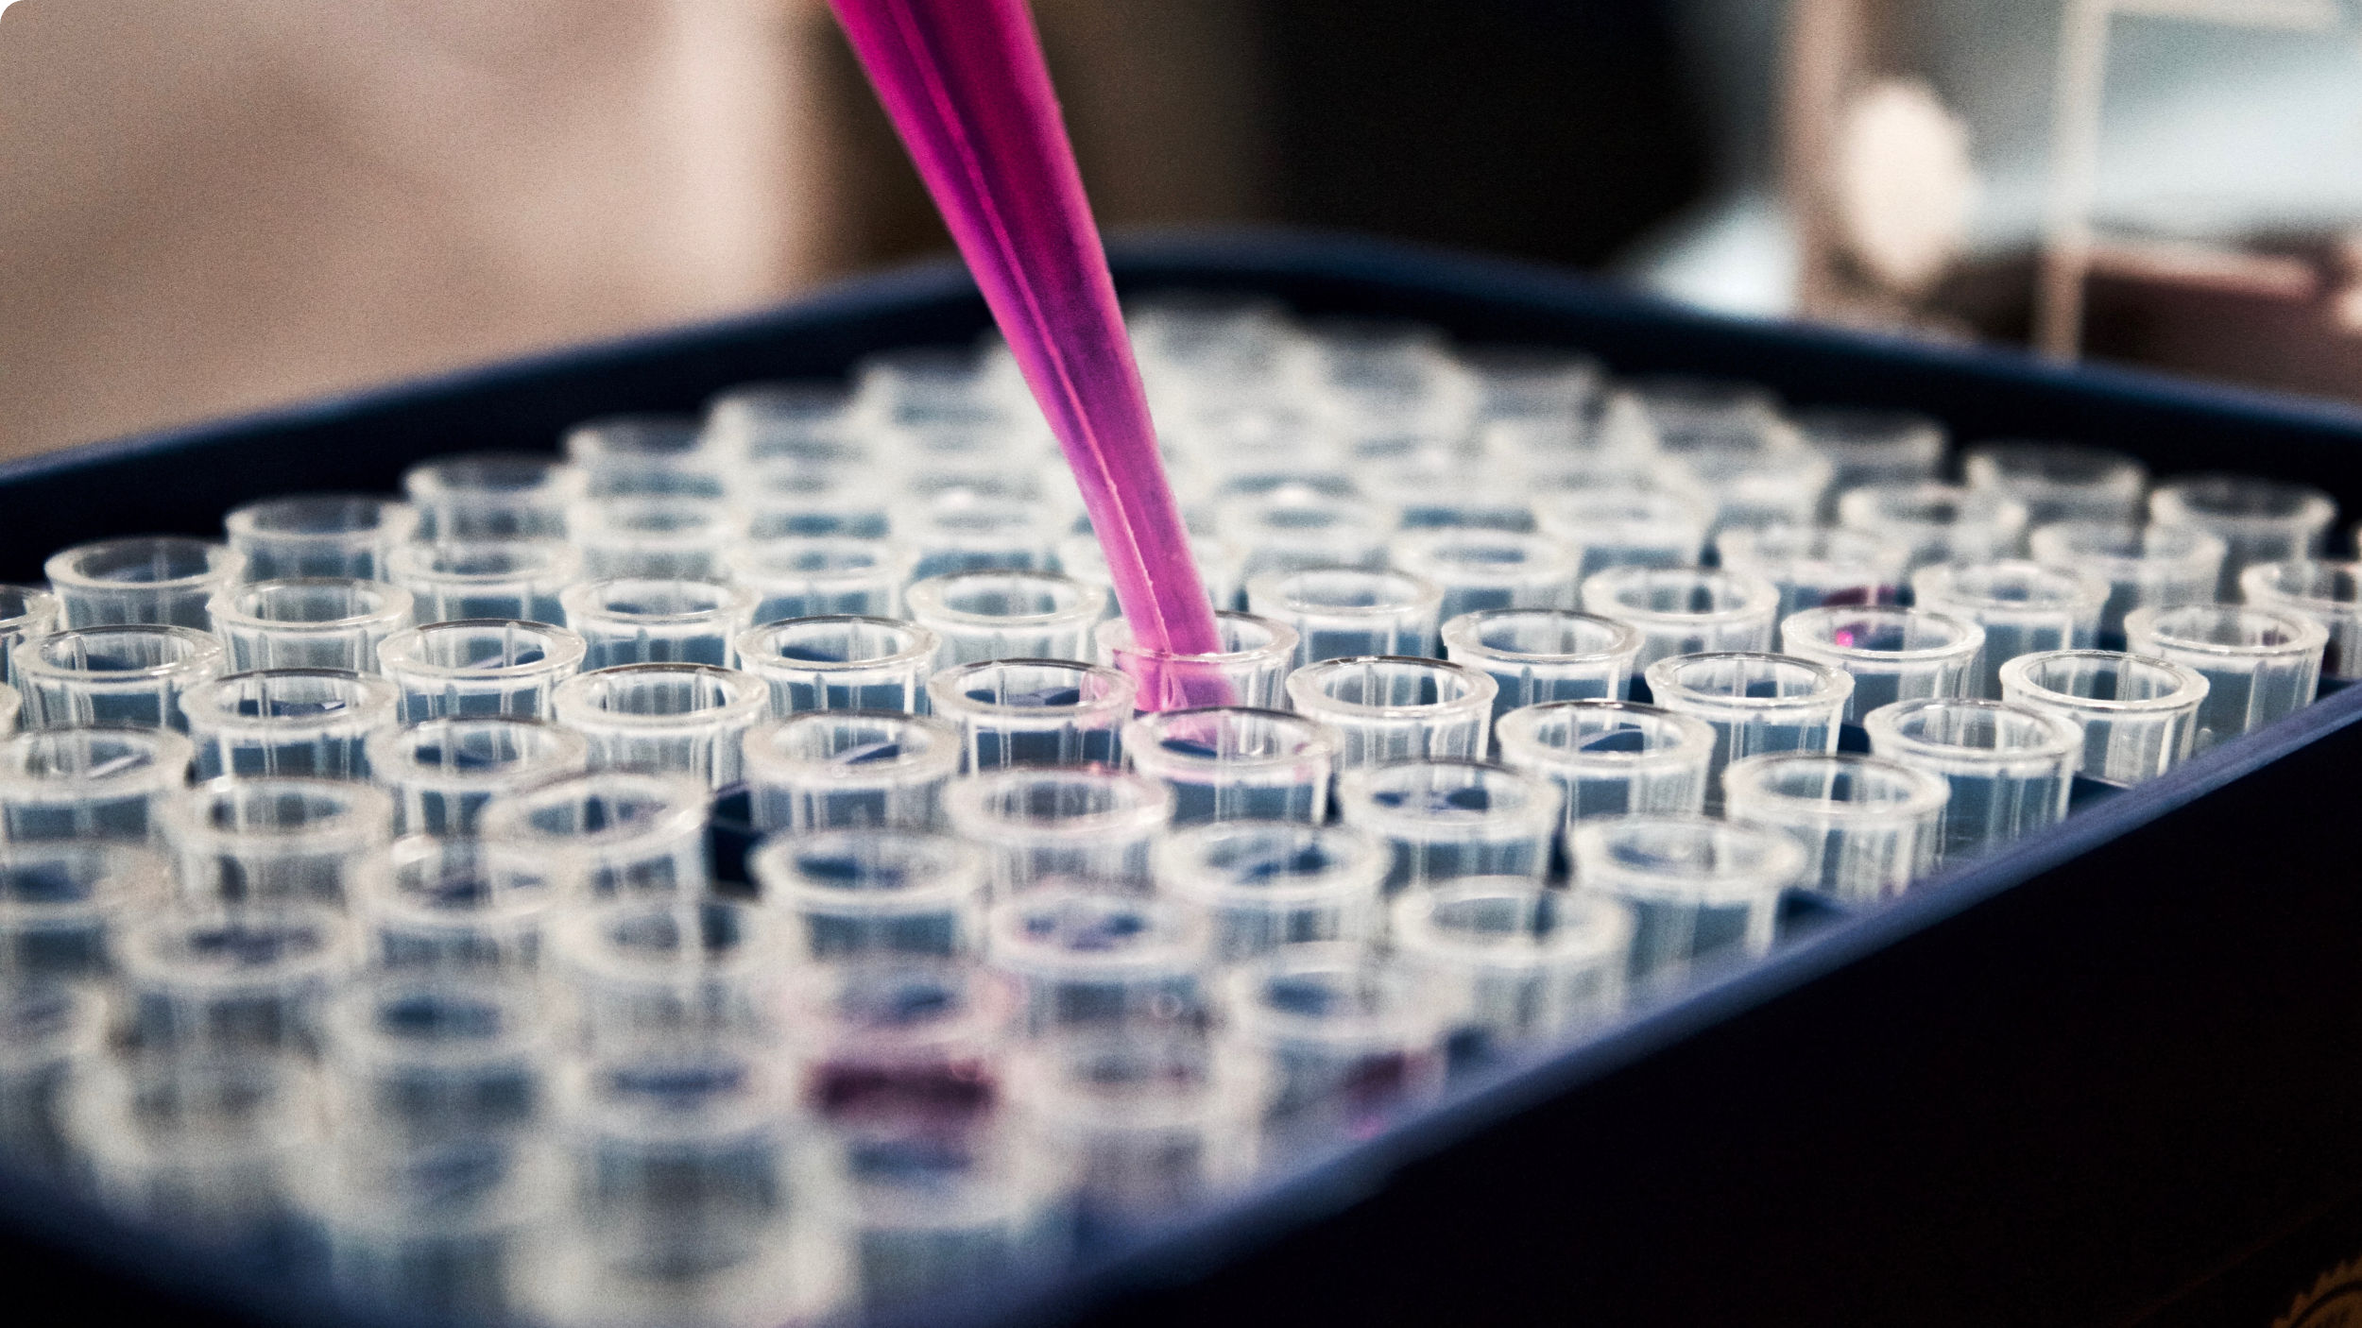



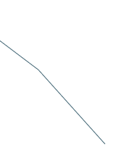
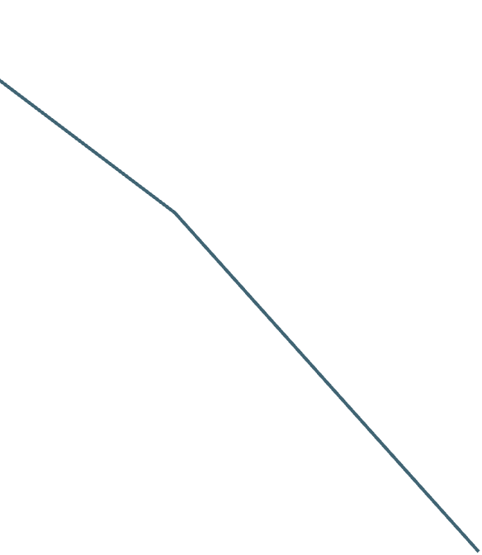
























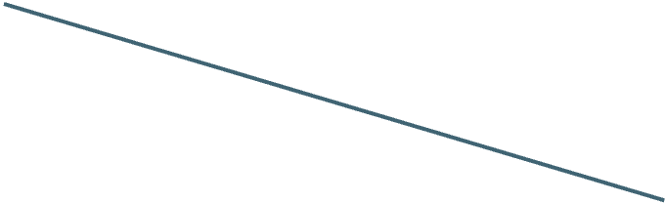
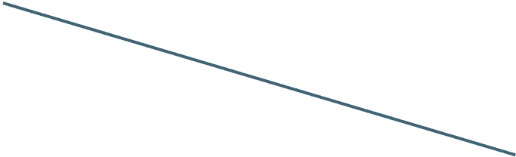
Consolidation of Existing Research Work
Consolidating prior research to advocate for aging biomarkers in trials, emphasizing their vital role in assessing intervention impacts on age-related processes.
Creative Commons Licence CC BY-NC 4.0

Slide 16

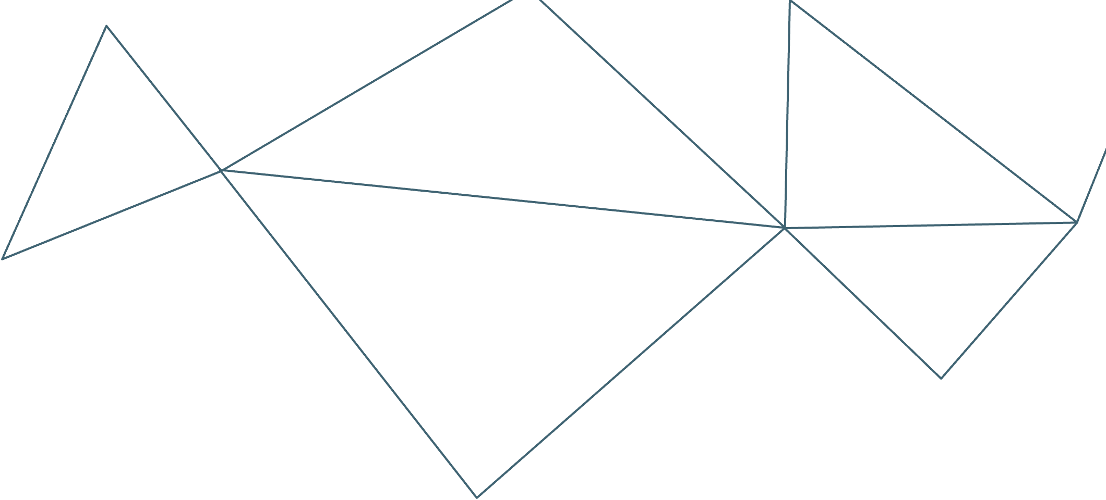










Determinants of accelerated metabolomic and epigenetic aging in a UK cohort
Metabolomic Age Model: Developed a model of age using metabolic profiling in a large UK cohort (N = 2,239).
Validation in Finnish Cohort: Validated the model in a Finnish cohort with repeat measurements from 2,144 individuals.
Determinants of Accelerated Aging: Explored factors contributing to accelerated aging, including lifestyle and psychological risk factors.
Metabolomic Age Acceleration (mAA): Found that increased mAA was associated with conditions like overweight/obesity, diabetes, heavy alcohol use, and depression.
DNA Methylation Age: Examined DNA methylation age acceleration but found it uncorrelated with mAA.
Phenotypic Age Acceleration: Identified associations between phenotypic age acceleration and factors like heavy alcohol use, hypertension, and low income.
Conclusion: Concluded that metabolomics is a promising tool for assessing biological age, complementing established epigenetic clocks.
Reference Link :
View Link
Creative Commons Licence CC BY-NC 4.0

Slide 17





2. Understanding Aging: Highlighted the potential of unsupervised learning in uncovering aging principles and dynamics from complex longitudinal data.
Unsupervised Learning for Aging Principles: Utilized analytical and machine learning tools to understand aging dynamics from longitudinal data.
Dynamic Frailty Indicator (dFI): Developed a deep neural network model, including auto-encoder and auto-regression components, to measure aging through the dynamic frailty indicator.
Predictive Power: Found that dFI could predict remaining lifespan, and its changes were consistent with late-life mortality patterns.
Hallmarks of Aging: Observed that dFI changes correlated with aging hallmarks such as frailty, inflammation markers, and senescent cell accumulation.
Response to Interventions: dFI responded to interventions like a high-fat diet (life-shortening) and rapamycin (life-extending), indicating its sensitivity to physiological changes.
Understanding Aging: Highlighted the potential of unsupervised learning in uncovering aging principles and dynamics from complex longitudinal data.
Reference Link :
View Link
Creative Commons Licence CC BY-NC 4.0

Slide 18





3. Heterogeneous aging across multiple organ systems and prediction of chronic disease and mortality
Multisystem Biological Aging: Studied biological aging in multiple organ systems by analyzing brain imaging and physiological data from the UK Biobank.
Interconnected Organ Aging: Discovered that an organ's biological age influences the aging process in other organ systems, indicating a multiorgan aging network.
Chronic Disease Profiles: Developed normative models for biological age in different organs and identified advanced biological aging associated with 16 chronic diseases.
Lifestyle and Environmental Factors: Found associations between advanced body age and lifestyle choices, environmental factors, and leukocyte telomere lengths.
Predictive Power: Demonstrated that advanced biological aging can predict mortality risk, survival time, and premature death, providing valuable insights into health outcomes.
Early Risk Identification: Suggested the potential for early identification of individuals at risk of aging-related health issues and strategies to address organ-specific aging.
Reference Link :
View Link
Creative Commons Licence CC BY-NC 4.0

Slide 19





4. The Hallmarks of Aging
Progressive Loss of Physiological Integrity: Aging involves a gradual decline in physiological function, increasing the risk of diseases and mortality.
Key Risk Factor for Diseases: Aging is the primary risk factor for major diseases like cancer, diabetes, cardiovascular issues, and neurodegenerative disorders.
Genetic and Biochemical Control: Recent research has revealed that genetic pathways and biochemical processes play a role in controlling the rate of aging.
Nine Hallmarks of Aging: Identified nine common hallmarks of aging across various organisms, particularly focusing on mammalian aging.
Hallmarks Include: Genomic instability, telomere attrition, epigenetic changes, proteostasis loss, nutrient-sensing deregulation, mitochondrial dysfunction, cellular senescence, stem cell depletion, and altered intercellular communication.
Interconnected Hallmarks: The challenge lies in understanding how these hallmarks are interconnected and their relative contributions to the aging process.
Pharmaceutical Targets: The ultimate goal is to find pharmaceutical targets to enhance human health during aging with minimal side effects.
Creative Commons Licence CC BY-NC 4.0
Reference Link :
View Link

Slide 20





5. Biological Age Estimation Using Circulating Blood Biomarkers
Biological Age (BA) vs. Chronological Age: BA is a more accurate measure of physiological decline than chronological age and can be influenced by interventions.
Blood-Based Biomarkers for BA: Blood biomarkers are suitable for estimating BA.
Machine Learning for BA Estimation: Machine learning models using circulating biomarkers from the UK Biobank improve BA estimation.
Cox Model with 25 Biomarkers: An Elastic-Net derived Cox model with 25 selected biomarkers predicts mortality risk and outperforms the PhenoAge model by 9.2%.
Clinical Assay Panels: Using common clinical assay panels with fewer biomarkers, along with imputation, maintains predictive accuracy.
BA Definition: BA is estimated as an age equivalent within the same-sex population, indicating an individual's mortality risk.
Wide Range of BA Values: BA values can vary from 20 years younger to 20 years older than an individual's chronological age, highlighting the significance of aging signals in blood markers.
Reference Link :
View Link
Creative Commons Licence CC BY-NC 4.0

Slide 21







6. Longitudinal analysis of blood markers reveals progressive loss of resilience and predicts human lifespan limit
CBC Measurements and Aging: Longitudinal data from CBC measurements were analyzed to understand aging dynamics.
Dynamic Organism State Indicator (DOSI): DOSI, a log-linear mortality estimate derived from CBC variables, served as a quantitative measure of aging.
Physiological Resilience and Aging: Broadening of the age-dependent DOSI distribution indicated a progressive loss of physiological resilience during aging.
Predicted Critical Point: Extrapolation suggested a critical point at 120-150 years of age, marking a complete loss of resilience.
Confirmation by Wearable Device Data: Analysis of physical activity data from wearable devices independently confirmed this critical point.
Intrinsic Biological Property: The criticality leading to the end of life is an intrinsic biological characteristic independent of external stress factors, representing a fundamental limit to human lifespan.
Reference Link :
View Link
Creative Commons Licence CC BY-NC 4.0

Slide 22
7. The Aging Biomarker Consortium represents a new era for aging research in China
Biomarkers can be classified into six categories: physiological characteristics; imaging traits; histological features; cellular alterations; molecular changes; and secretory factors.
These six categories provide a framework for mechanistic studies of the fundamental principles of aging that uncover cellular and molecular insights into regulatory networks that govern the aging process
.
Integrating multi-omics data, including (single-cell) tran-scriptome, proteome, epigenome, metabo-lome, metagenome and phenome data to launch the Aging Index initiative aided by Artificial Intelligence
The ABC will establish an accurate biological-age-evaluation system for the Chinese population, which can serve as a foundation for future collaboration with other aging research consortia worldwide
The consortium seeks to build closer partnerships for health cooperation, connectivity, green development, openness, diversity and inclusiveness to advance
the understanding of aging and to extend the healthspan of humans in a community of common health for mankind
Reference Link :
view Link
Creative Commons Licence CC BY-NC 4.0

Slide 23
8. The AFAR FAST initiative
The American Federation for Aging Research (AFAR) focuses on advancing aging research through grant programs, fellowships, and leading studies like the FAST Initiative, Tame Trial​
The TAME (Targeting Aging with Metformin) Trial is a significant six-year clinical trial across 14 research institutions, aiming to test if metformin can delay the progression of age-related chronic diseases in individuals aged 65-79​
The trial seeks to establish aging as a treatable condition and gain FDA approval for aging as an indication for treatment.
The successful outcome of the TAME Trial could open up new avenues for treatments targeting the biology of aging, thus potentially revolutionizing the future of healthy aging and biotech innovation.​
Reference Link View Link​:
Creative Commons Licence CC BY-NC 4.0

Slide 24
9. Biomarkers of Aging Challenge
Competition launched by the Biomarkers of Aging Consortium, Methuselah Foundation, VoLoFoundation
competition was launched on December 4, 2023 and will have three consecutive tracks for the prediction of chronological age, mortality, and multi-morbidity. The competition will be hosted on Synapse and the winning models for each track will receive a cash prize.
Challenge Timeline and Awards
12/4/2023 - Team formation, open registration, and public comment phase begins.
Q2 2024 - Phase 1 - Chronological Age Prediction Challenge - $30k in awards
Q3 2024 - Phase 2 - Longevity Prediction Challenge (mortality) - $70k in awards
November 1, 2024 - Winners celebration
TBD 2025 - Healthspan Prediction (multi-morbidity) - $100k in awards
Reference: View Website
Creative Commons Licence CC BY-NC 4.0

Slide 25
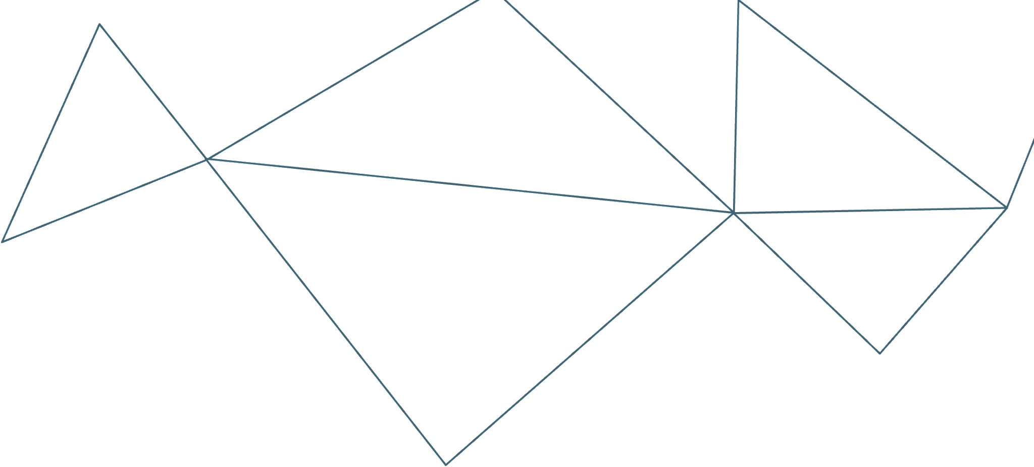
10. Antiaging Strategies and Remedies: A Landscape of Research Progress and Promise
The objective of this review using data from the CAS Content Collection is to summarize current knowledge on preventive strategies and treatment remedies in the field of aging
Among all antiaging interventions, dietary interventions have demonstrated the greatest promise. Two related dietary interventions, caloric restriction and intermittent fasting, have been reported to effectively prolong the healthy lifetime of the nervous system by affecting basic metabolic and cellular signalling pathways that regulate longevity.
The key physiological routes that have been inferred as potential mechanisms by which caloric restriction stimulates longevity include (i) activation of AMP protein kinase (ii) sirtuins activation (iii) insulin-like growth factor-1 signaling inhibition and (iv) mammalian target of rapamycin inhibition. Recognising the behavioural challenges of following caloric restricted practice, examples of the most widely examined caloric restriction mimetics include rapamycin, metformin, resveratrol, acarbose, aspirin, glucosamine, nicotinamide riboside, and spermidine.
Physical exercise has been well validated as an effective antiaging intervention. Regular physical activity of the elderly plays a vital role at a multisystem level, avoiding muscle atrophy, mending or sustaining cardiorespiratory health and cognitive performance, and enhancing metabolic activity. Physical exercise exhibits a significant antiaging impact at a cellular level, related to each and every aging hallmark. One of the best strategies
for healthy brain aging is regular aerobic exercise.
Reference: view link
Creative Commons Licence CC BY-NC 4.0

Slide 26
11. Atlas of plasma NMR biomarkers for health and disease in 118,461 individuals from the UK Biobank
UK Biobank is a prospective study of ~500,000 individuals who have volunteered to have their health information shared with scientists across the globe to advance public health research. This open resource is unique in its size and availability of extensive phenotypic and
genomic data. The extensive electronic health records in the UK Biobank and the
unprecedented sample size make it possible to study biomarker
associations across the full spectrum of common diseases.
Blood lipids and metabolites are markers of current health and future disease risk. This study describes plasma nuclear magnetic resonance (NMR) biomarker data for 118,461 participants in the UK Biobank, and highlights the value of NMR based metabolic biomarker profiling in large biobanks for public health research and translation.
Examining the NMR biomarkers across the spectrum of common diseases can provide insights into disease pathophysiology and specificity of the biomarkers. Typically denoted ‘metabolic biomarkers’, analyses reveal that many of these biomarkers capture risk for many other diseases as well. This includes the future onset of diseases of the joints, bones, lungs, many different cancers as well as many mental disorders diseases and severe infectious diseases.
These results explain earlier reports on strong associations of the NMR biomarkers with all-cause mortality, since many of the biomarkers are associated broadly with
leading causes of morbidity and mortality. Plasma metabolites are increasingly understood to link to multimorbidities.
Creative Commons Licence CC BY-NC 4.0
Reference: view link

Slide 27
12. Metabolomic profiles predict individual multidisease outcomes
Risk stratification is critical for the early identification of high-risk individuals and disease prevention. This study explored the potential of nuclear magnetic resonance (NMR) spectroscopy-derived metabolomic profiles to inform on multidisease risk beyond conventional clinical predictors for the onset of 24 common conditions, including metabolic, vascular, respiratory, musculoskeletal and neurological diseases and cancers.
The researchers trained a neural network to learn disease-specific metabolomic states from 168 circulating metabolic markers measured in 117,981 participants with ~1.4 million person years of follow-up from the UK Biobank and validated the model in four independent cohorts. They found metabolomic states to be associated with incident event rates in all the investigated conditions, except breast cancer.
.
Overall, the study demonstrated both the potential and limitations of NMR-derived metabolomic profiles as a multidisease assay to inform on the risk of many common diseases simultaneously.
Reference: view link
Creative Commons Licence CC BY-NC 4.0

Slide 28
13. Heterogeneous aging across multiple organ systems and prediction of chronic disease and mortality
Biological aging of human organ systems reflects the interplay of age, chronic disease, lifestyle and genetic risk. Using longitudinal brain imaging and physiological phenotypes from the UK Biobank, this study established normative models of biological age for three brain and seven body systems, and found that an organ’s biological age selectively influences the aging of other organ systems, revealing a multiorgan aging network.
While epigenetic clocks are clinically useful and provide important insights into aging biology across tissue types, it is now recognized that aging varies markedly between organ systems and tissues, particularly in disease. Bespoke organ and disease-specific aging clocks are thus needed to enhance the clinical utility of existing pan-tissue clocks, which do not readily differentiate between tissue components and body systems.
The study showed that investigation into environmental and lifestyle factors can inform real-world personalized interventions targeted at specific body systems, through change of lifestyle, such as limiting tobacco smoking and alcohol intake, exercise, education, sleep hygiene and maternal nutrition, as well as efforts requiring national inputs such as
reductions in socioeconomic inequality and air pollution, and improvements
in residential greenspace and natural environment coverage.
Reference: view link
Creative Commons Licence CC BY-NC 4.0

Slide 29
14. Validation of biomarkers of aging
Targeting aging itself has the potential to forestall multiple aging-associated disease processes simultaneously. Biomarkers of aging have started to provide clues on the biological mechanisms of aging.
Biomarkers that quantify biological aging (particularly ‘omic’-based biomarkers) could predict aging-related outcomes and serve as surrogate endpoints for the evaluation of interventions promoting healthy aging and longevity. However, no consensus exists on how biomarkers of aging should be validated before their translation to the clinic.
The ideal biomarkers of aging shall have moderate to strong associations with chronological age and predict multiple aging-related outcomes beyond mortality, such as functional decline, frailty, chronic diseases and disability and (multi)morbidity. They
should be sensitive to upstream factors thought to influence aging such as stress, adverse events, environment, genetics and lifestyle, and they should mediate the relationship between these factors and aging outcomes.
Biomarkers of aging that meet these requirements should be prioritized for validation as screening and diagnostic biomarkers and eventually as surrogate endpoints in clinical trials. Harmonization and standardization of biomarkers and population data across the field will greatly enhance our ability to identify, characterize and validate the most promising biomarker candidates.
Reference: view link
Creative Commons Licence CC BY-NC 4.0

Slide 30
15. China Aging Biomarkers Consortium
Biomarkers can be classified into six categories: physiological characteristics; imaging traits; histological features; cellular alterations; molecular changes; and secretory factors. These six categories provide a framework for mechanistic studies of the fundamental principles of aging that uncover cellular and molecular insights into regulatory networks that govern the aging process1.
To qualify as a robust biological measurement of aging, a biomarker must have three essential characteristics: it must be specific (to the extent and rate of aging rather than pathological effects); it must be systemic (when combined, a group of biomarkers should reflect multi-dimensional changes in certain systems); and it must be serviceable (for translation into clinical practice).
By providing a comprehensive repository of aging biomarkers and proposing standards for their measurement, the ABC is poised to make considerable contributions to aging research and clinical practice. Through collaborations among consortium members, the ABC aims to address the following critical topics in aging research: how reliable and valid aging biomarker systems can be constructed in population-based studies; how aging biomarkers can be used to understand the fundamental
principles of aging; how biological aging risk information can be effectively analyzed; how the efficacy of aging interventions can be assessed with a collection of biomarkers; and how the influence of socioeconomic factors on individual aging can be evaluated while potential ethical issues are avoided.
Reference: view link
Creative Commons Licence CC BY-NC 4.0

Slide 31
16. Human Aging and Longevity Landscape (HALL)
The HALL database aims to collect comprehensive and multi-dimensional datasets from diverse
human cohorts, spanning a wide range of ages from young and old individuals to centenarians.
The HALL also functions as an open-accessed knowledgebase, featuring meticulously curated
information regarding aging- and longevity-associated genes, biomarkers, and biological age
clocks.
The database is an integrated resource that offers valuable information for indicative
biomarkers that monitor aging pace, the development of diagnostic tools for aging-related diseases,
and targeted aging interventions. The database aims to support advancements in scientific
research, clinical practice, and industry initiatives, providing valuable knowledge for professionals
working in the field of human physiology and pathology, especially aging, aging-related diseases,
and longevity.
The core component of the database currently includes eight distinct omics data types: phenomics, genomics, epigenomics, bulk and single-cell transcriptomics, proteomics, metabolomics, metagenomics, and pharmacogenomics
Reference: view link
Creative Commons Licence CC BY-NC 4.0

Slide 32
17. Biomarkers of aging for the identification and evaluation of longevity interventions
The current lack of standards and consensus on the properties of a reliable aging biomarker hinders their further development and validation for clinical applications.
Biological age is a more relevant measure for evaluating the efficacy of longevity interventions, as it encompasses the extent of age-related damage and deterioration. The concept of "age deviation" (AgeDev) is introduced to quantify variations in the aging process among individuals of the same chronological age, underscoring the importance of identifying biomarkers that accurately reflect biological rather than chronological aging​​
The paper emphasizes the importance of biomarkers in aging that mirror the cellular and molecular changes responsible for age-related declines. It suggests focusing on biomarkers grounded in biology, like epigenetic clocks, for deeper insights into aging mechanisms and to better measure the impact of anti-aging interventions.
An interesting aspect covered is the importance of cross-species generalizability of biomarkers, which allows for the extrapolation of findings from model organisms to humans. This necessitates the identification of biomarkers that capture fundamental molecular and cellular aging processes common across different species, enabling a more universal approach to understanding and intervening in the aging process​​.
Reference: view link
Creative Commons Licence CC BY-NC 4.0

Slide 33







Stakeholder Roadmap
To Utilize existing D2C apps for decentralized clinical trials, showcasing a cost-effective, personalized trial model with reduced regulatory hurdles worldwide.
To Demonstrate that our aging metrics lead to decreased disease and death risk, validating the efficacy of decentralized trials for diverse variables and maintaining data privacy through advanced techniques.
Creative Commons Licence CC BY-NC 4.0

Slide 34
End Goal
To obtain validated regulatory approval for aging clocks/biomarkers as surrogate endpoints and to test various aging drugs and lifestyle interventions, creating models that can inform personalized health optimization protocols.
Creative Commons Licence CC BY-NC 4.0

Slide 35


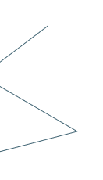

Questions??
How can we encourage more international collaboration in the field of aging biomarkers for clinical trials?
2. Are there any challenges or barriers to adopting aging biomarkers in clinical trials on a global scale, and how can we address them?
3. In what ways can the research community and pharmaceutical companies contribute to advancing the use of aging biomarkers in clinical trials?
4. What examples or success stories of using aging biomarkers in trials can be shared to inspire further collaboration and adoption?
Creative Commons Licence CC BY-NC 4.0

Slide 36









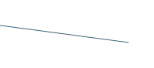
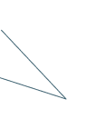


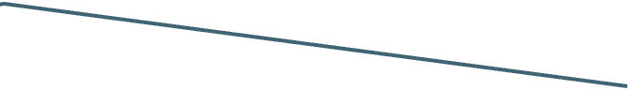






















THANK YOU
"Age is not measured by years, but by the condition of health."
Creative Commons Licence CC BY-NC 4.0

